Slide 1
The Student Experience at UWS
By Kirsty, Paul and Ryan

Slide 2
Description

Slide 3
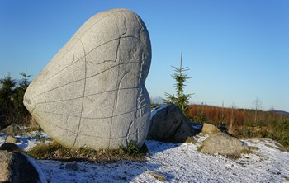
Kirsty’s Background
Born in Dumfries 22nd of April 1993.
Grew up in Dalbeattie.
I’m Catholic and go to church.
I have played a lot of different sports in the past. Including football, tennis and badminton.
I am a waitress/ barmaid at the Anchor Hotel in Kippford.

Slide 4
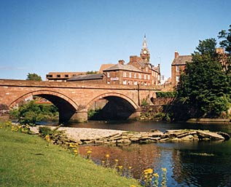
Paul’s Background
Born in Dumfries 7th of October 1993
Grew up in Annan
I play football every Tuesday in Dumfries.
Go to my nanas everyday.
A year experience at DGRI

Slide 5
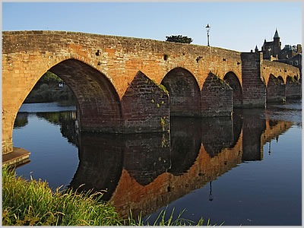
Ryan’s Background
I was born in Dumfries on the 14th of June 1993.
Grew up in Lochside.
Worked at local Morrisons for a year

Slide 6
Ryan’s Approach to Learning
Notes:
All

Slide 7
Time Management
I work a part time job as well as uni work.
My part time job taught me how to multi task better and how important time management is.
I travel to university using my own car.

Slide 8
My Approach to Learning
I enjoy a challenge and learning something new.

Slide 9
My Approach to Assessment
Assessments are difficult and I require lots of revising to fell like I am going to pass.
But I am positive that I can learn new things from doing assessments.

Slide 10
Motivations
My motivations are the chance of failure will push me to get the best grade possible.

Slide 11
Paul’s Approach to Learning

Slide 12
Time Management
I currently don’t have a job so I have plenty of time to do uni work.
Worked at the hospital for a year and taught me how to save money from working
I travel to uni by car

Slide 13
My Approach to Learning
I enjoy learning new computing skills

Slide 14
My Approach to Assessment
I have a negative view towards assessments as I always worry that I’m going to fail

Slide 15
Motivations
My main motivation to do this course is to get a good job by the end of the course

Slide 16
Kirsty’s Approach to Learning

Slide 17
Time Management
Juggled school work, sports and part time job.
Part time job- taught me responsibility and importance of time keeping.
University- travel by bus.

Slide 18
My Approach to Learning
Positive
I enjoy learning and gaining new knowledge.

Slide 19
My Approach to Assessment
Assessment scares me.
But I take a positive attitude as I can learn from assessments.

Slide 20
Motivations
Ambition to do well.
I want a good job, that I enjoy.
Family and friends.
And you guys ☺

Slide 21
Group Work
How did we approach group-work and group-work management?
Same level of knowledge.
We all want to do the best we can.
Motivate each other.
Everyone has there say.
No-one is left out.
We are all easy going.
Me and Ryan have jobs.
Description of our group-based learning.
Created PowerPoints and have a report.
Future- will be more challenging and complex tasks.
Notes:
Kirsty

Slide 22
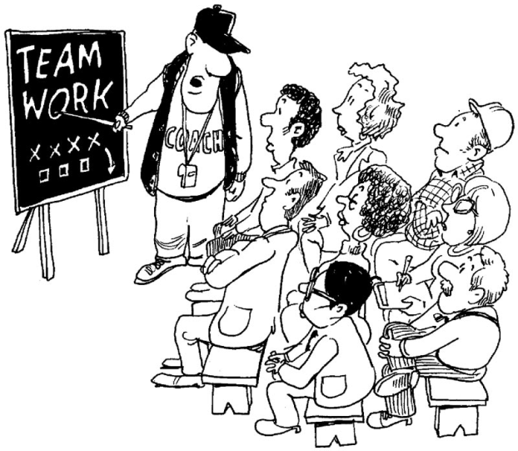
How group work affected our experiences
What were the costs/benefits of group work?
Benefits- always had each other for help and had 3 points of view instead of just our own.
Costs- sometimes did not agree. Had to come to an agreement.
Notes:
Ryan

Slide 23
Induction was long. Advice given was not very useful.
Our Recommendations for the improvement of the student experience
Notes:
paul

Slide 24

Member Evaluation
Kirsty
Paul
Ryan
Notes:
All of us

Slide 25
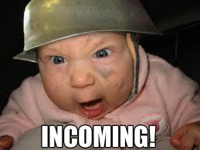
Any Questions?

